Slide 1

Department of Computer Science & Engineering AI Based Resume Screening Web Applicaton 1.2411CS010202(G. Rithwik) 2.2411CS010216(I.Seshasayee) 3.2411CS010399(N.Srikanth)
Maisammaguda, Kompally, Medchal - Malkajgiri District Hyderabad - 500100, Telangana State. www.mallareddyuniversity.
(Telangana State Private Universities Act No. 13 of 2020 &
G.O.Ms. No. 14, Higher Education (UE) Department)

Slide 2
Table of Contents
Introduction
Literature Survey
Limitations of Existing Algorithms/Methodologies
Abstract
Screenshots of Working Model
Conclusion

Slide 3
Introduction
The AI-Based Resume Screening Web Application is designed to automate the process of evaluating resumes during recruitment. In traditional hiring, recruiters manually review resumes, which is time-consuming and may lead to inconsistency. This system uses Machine Learning (ML) and Natural Language Processing (NLP) techniques to analyze resumes and compare them with job requirements.
The system extracts relevant information such as skills, qualifications, and experience from resumes and evaluates their suitability for a given job role. This improves efficiency, accuracy, and reduces human effort in the recruitment process.

Slide 4
Literature Survey
Keyword-Based Systems : These systems match resumes with job descriptions using simple keyword matching. However, they lack accuracy and fail to understand context.
Machine Learning-Based Systems : These use algorithms like TF-IDF and classification models to improve matching accuracy.
NLP-Based Systems : Advanced systems use NLP techniques to understand semantic meaning, improving the quality of matching.

Slide 5
Limitations of Existing System
Keyword matching does not understand context
High chances of missing relevant candidates
Cannot identify synonyms (e.g., “ML” vs “Machine Learning”)
Manual screening is time-consuming
Lack of scalability for large datasets
Some systems are biased or inconsistent

Slide 6
Abstract
The AI-Based Resume Screening System is designed to automate the process of evaluating candidate resumes for specific job roles. The system analyzes the content of a resume and identifies relevant skills and qualifications. It then compares these with predefined job requirements to determine the suitability of the candidate. Using an intelligent keyword matching approach, the system classifies resumes as suitable or not suitable for the selected role. This reduces manual effort and improves consistency in the screening process. The system helps in quickly identifying candidates who meet the required criteria, enabling a more efficient and structured recruitment process through automated decision-making.

Slide 7
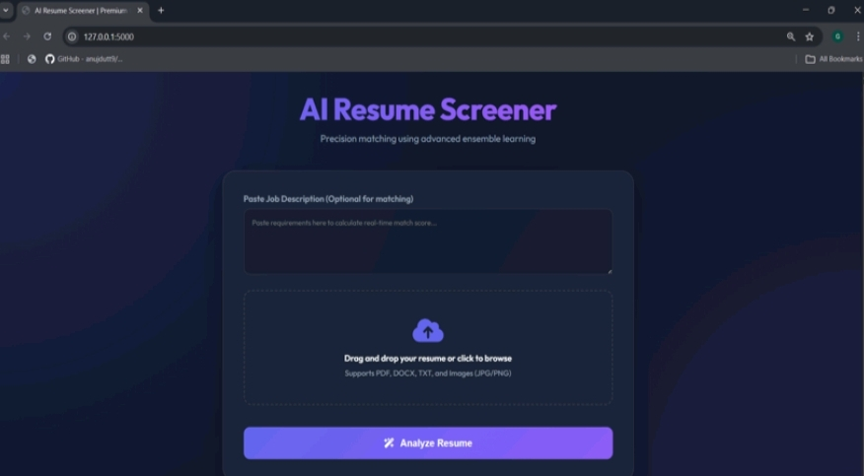
Screenshots Of Working Model Resume Upload Page

Slide 8
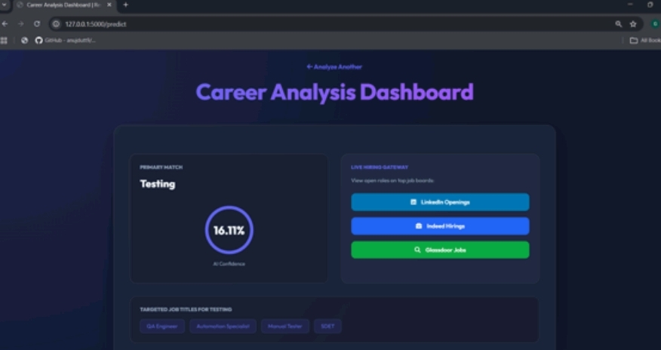
Career Analysis Dashboard

Slide 9
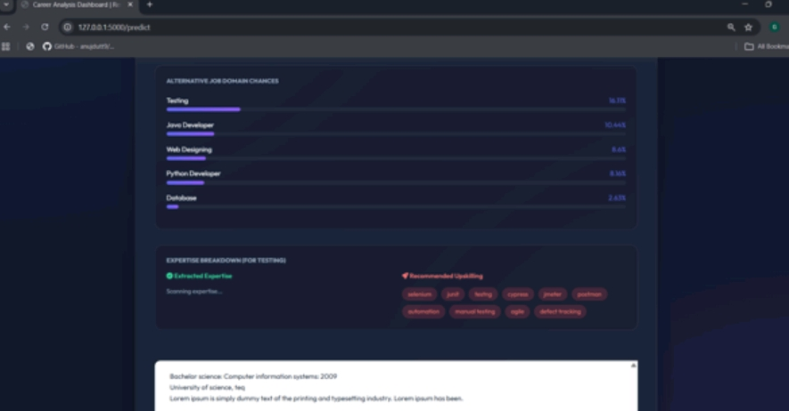
Career Analysis Dashboard

Slide 10
Results
The AI-Based Resume Screening Web Application provides an effective solution to automate the traditionally time-consuming process of resume evaluation. By leveraging machine learning techniques, the system minimizes manual effort and speeds up the recruitment workflow. This automation not only saves time for recruiters but also allows them to focus on more strategic decision-making tasks.
Furthermore, the project demonstrates the practical application of artificial intelligence in improving modern recruitment processes. It highlights how machine learning can be integrated into real-world systems to enhance efficiency, scalability, and accuracy in decision-making.

Slide 11
Conclusion
The AI-Based Resume Screening Web Application successfully automates the process of resume evaluation using machine learning techniques. It reduces manual effort, increases efficiency, and ensures consistent candidate selection. By using techniques like TF-IDF and cosine similarity, the system accurately matches resumes with job descriptions.
This project demonstrates how AI can improve recruitment processes and can be further enhanced using advanced NLP models and real-time integration with job portals.

Slide 12
THANK YOU

